Slide 1
CodingHive 2019
React Training
December 14th, 2019

Slide 2
Who am I?
Lead Software Engineer @ Intrasoft International
Research Fellow in University of Piraeus
Core contributor in various open source projects (Vaadin Flow, Drupal)
Ambassador of OracleJET and Prestashop
Email: panagiotis.adamopoulos@intrasoft-intl.com
Github: https://github.com/panosadamop
Linkedin: https://www.linkedin.com/in/padamopoulos/

Slide 3
The web evolution

Slide 4
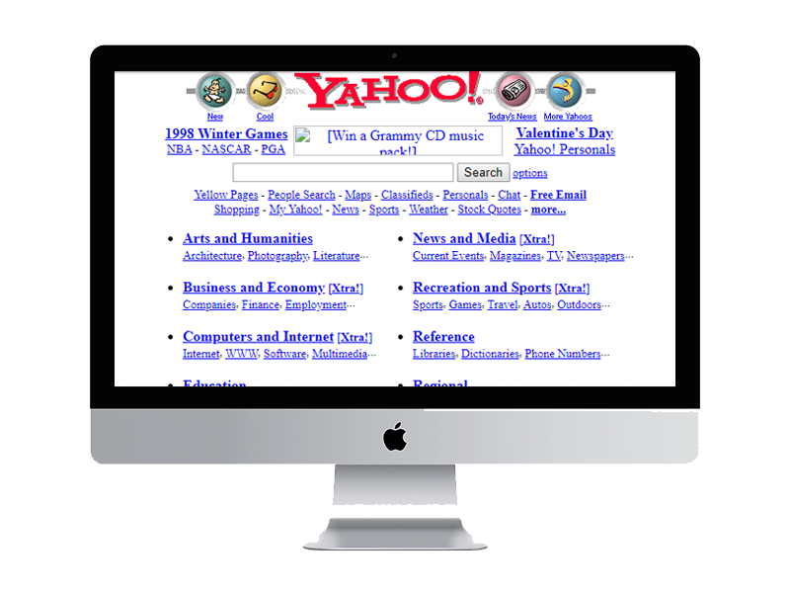


The web evolution
HTML specification was made public in late 1991 by Tim Berners-Lee.
CSS was proposed by Håkon Wium Lie in October 1994
1997 – 200x
Static Sites, Javascript, VBScript
Flash Websites
Dialup and slow ADSL connections
Around 2007 - 2008
Web application made a trend
.NET, php, jsp, database usage, CMS
Fast internet connections
Today
Various Frameworks
MicroServices & MicroApps
Enterprise Web Applications

Slide 5
The web evolution
Year (June) | Websites
2018 | 1,630,322,579
2017 | 1,766,926,408
2016 | 1,045,534,808
2011 | 346,004,403
2010 | 206,956,723
2009 | 238,027,855
2001 | 29,254,370
2000 | 17,087,182
1999 | 3,177,453
1995 | 23,500
1994 | 2,738

Slide 6
The web evolution
CSS Frameworks (first attempt for CSS with ACID tests)
In mid-2000s, CSS libraries and frameworks began cropping up (Bluprint, 960gs)
Javascript Frameworks
Jquery released on August 2006 and standardized cross-browser compatibility and AJAX technology(existed since 1996)
AngularJS came into market in 2010. After that we had Bower, Gulp, Webpack, Backbone, Knockout, React, Vue etc
Today we are talking about Micro-Frontends, MicroApps, FrontEnd Architectures etc

Slide 7
The web evolution
Frameworks are designed
to help us deal with
complexity.

Slide 8
The web evolution
...but frameworks themselves
also introduce complexity of their own.
Notes:
Learning Curve
Specific Guidelines
Και όσο μεγαλύτερο το framework τόσο περισσότερο δύσκολα είναι

Slide 9
The web evolution
Application Complexity
vs.
Framework Complexity
Notes:
Η πολυπλοκότητα του προβλήματος και του εργαλείου.

Slide 10

The web evolution
Pick the right tool
for the job
Notes:
Η πολυπλοκότητα του προβλήματος και του εργαλείου.

Slide 11
React Introduction

Slide 12
Why was React developed?
Complexity of two-way data binding
Bad UX from using "cascading updates" of DOM tree
A lot of data on a page changing over time
Complexity of Facebook's UI architecture
Shift from MVC mentality

Slide 13







Who uses React?

Slide 14
React: the good
Easy to understand what a component will render
Declarative code → predictable code
You don't really need to study JS in the view file in order to understand what the file does
Easy to mix HTML and JS
You do it already with template libraries (e.g. Handlebars, Mustache, Underscore etc.)
Uses full power of JS
Decoupling templates from logic does not rely on the templates’ primitive abstractions, but uses full power of JavaScript in displaying views

Slide 15
React: the good
No complex two-way data flow
Uses simple one-way reactive data flow
Easier to understand than two-way binding
Uses less code
React is fast!
JavaScript is fast but real DOM is slow
Using virtual DOM objects enables fast batch updates to real DOM
React dev tools
React Chrome extension makes debugging so much easier
Server-side rendering
React.renderToString() returns pure HTML

Slide 16
React: the bad
React is nothing but the view
No events
No XHR
No data / models
No promises / deferreds
No idea how to add all of the above
Building JSX requires some extra work
But most of the work is already done for you by react-tools
No support for older browsers
React won't work with IE8
There some polyfills / shims that help

Slide 17
Why should I use React?
Easy to read and understand views
Concept of components is the future of web development
If your page uses a lot of fast updating data or real time data - React is the way to go
Once you and your team is over the React's learning curve, developing your app will become a lot faster

Slide 18
React Fundamentals

Slide 19
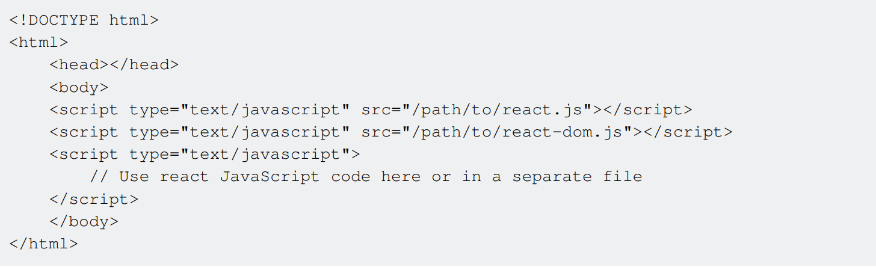
React Installation
ReactJS is a JavaScript library contained in a single file react-<version>.js that can be included in
any HTML page. People also commonly install the React DOM library react-dom-<version>.js
along with the main React file:
Resource: https://reactjs.org/docs/getting-started.html

Slide 20
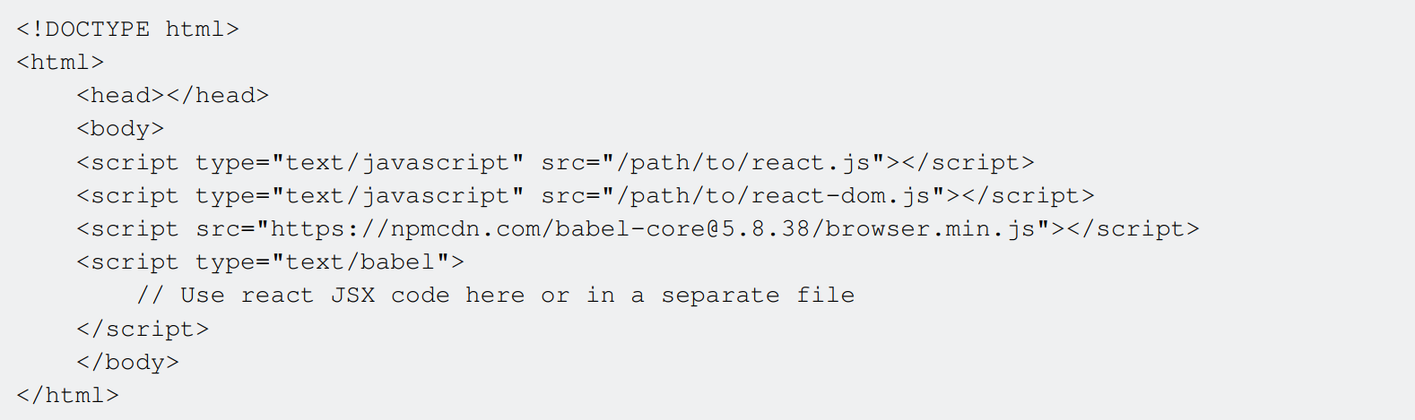
React Installation
React also supports JSX syntax.
JSX is an extension created by Facebook that adds XML syntax to JavaScript.
In order to use JSX you need to include the Babel library in order to translate JSX to Javascript code.
Resource: https://reactjs.org/docs/jsx-in-depth.html

Slide 21
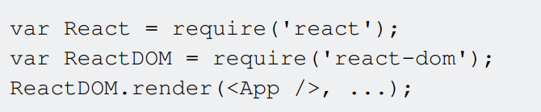
React Installation
NPM
React can also be installed using npm using the following command:
npm install --save react react-dom
YARN
React can also be installed using yarn (Facebook package manager) using the following command:
yarn add react react-dom
To use React in your JavaScript project, you can do the following:

Slide 22
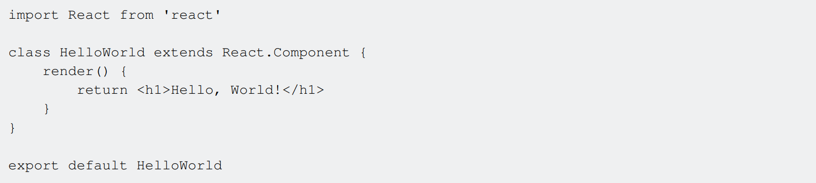
Hello World Component
A React component can be defined as an ES6 class that extends the base React.Component class.
A component must define a render method that specifies how the component renders to the DOM.
The render method returns React nodes, which can be defined using JSX syntax as HTML-like tags.

Slide 23
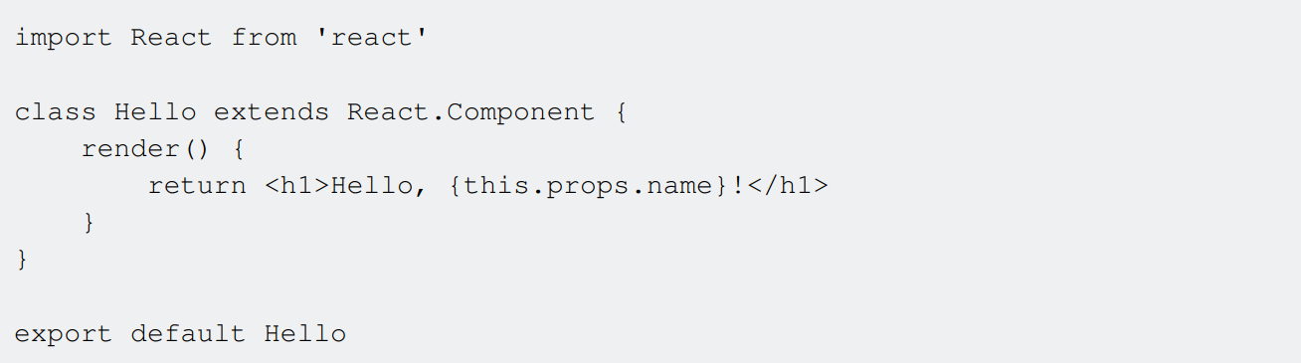
Hello World Component and Props
A Component can also receive props.
Props are properties passed by its parent in order to specify some values the component cannot know by itself; a property can contain a function that can be called by the component after certain events occur
Example: a button could receive a function for its onClick property and call it whenever it is clicked. When writing a component, its props can be accessed through the props object on the Component itself:
The component renders a string passed into the name prop by its parent. A component cannot modify the props it receives

Slide 24
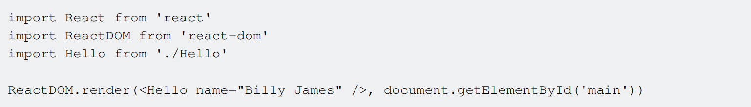
Hello World Component and Props
A component can be rendered within any other component, or directly into the DOM if it's the
topmost component, using ReactDOM.render and providing it with:
the component
the DOM Node where you want the React tree to be rendered
By now you know how to make a basic component and accept props.
Lets take this a step further and introduce state.

Slide 25
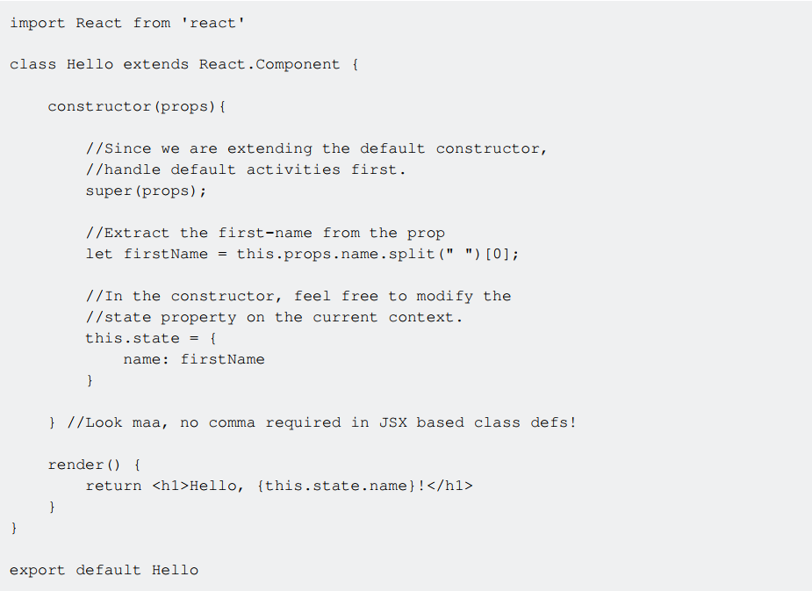
Hello World Component and State
By now you know how to make a basic component and accept props.
Lets take this a step further and introduce state.
Each component can have it's own state or accept it's parent's state as a prop.
Notes:
https://codepen.io/sunnykgupta/pen/mRPxdo?editors=1010

Slide 26
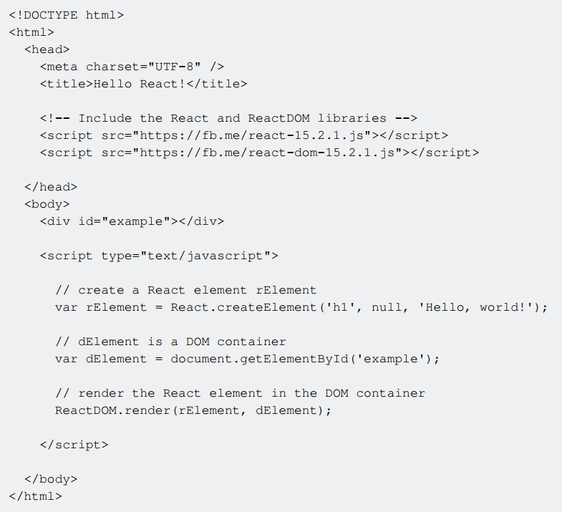
Hello World without JXS
Basic example that uses React's main API to create a React element and the React DOM API to render the React element in the browser.

Slide 27
Hello World with JXS
Instead of creating a React element from strings you can use JS:
as the equivalent (and easier to read for someone familiar with HTML)
The code containing JSX needs to be enclosed in a <script type="text/babel"> tag. Everything
within this tag will be transformed to plain Javascript using the Babel library.

Slide 28
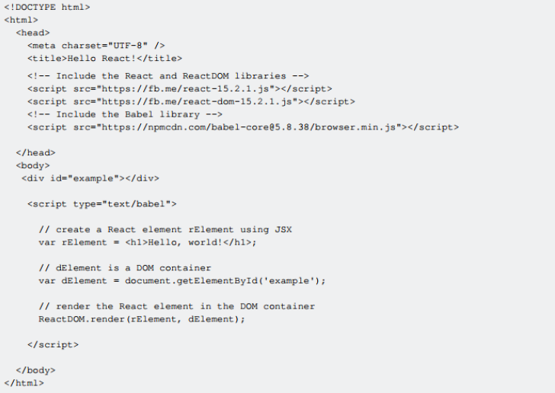
Hello World with JXS
So finally:

Slide 29
Create React App
create-react-app is a React app boilerplate generator created by Facebook. It provides a
development environment configured for ease-of-use with minimal setup, including:
ES6 and JSX transpilation
Dev server with hot module reloading
Code linting
CSS auto-prefixing
Build script with JS, CSS and image bundling, and sourcemaps
Jest testing framework
Alternative React boilerplates:
enclave nwb motion rackt-cli | budō rwb sagui roc

Slide 30




Create React App
Install create-react-app globally with node package manager (npm)
run the generator in your chosen directory
Navigate to the newly created directory and run the start script.
create-react-app is non-configurable. The eject command is used to edit the configuration files.
To build your app for production

Slide 31
Components and Props

Slide 32
Components and Props
The bulk of development in React is the creation of components.
A component represents a portion of the view of your application.
"Props" are simply the attributes used on a JSX node (e.g. <SomeComponent someProp="some prop's
value" />), and are the primary way our application interacts with our components.
Notes:
In the snippet above, inside of SomeComponent, we would have access to this.props, whose value would be the object {someProp: "some prop's value"}.
It can be useful to think of React components as simple functions - they take input in the form of "props", and produce output as markup.

Slide 33
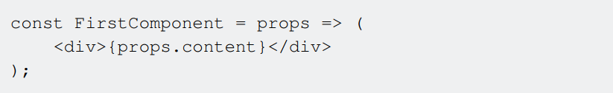
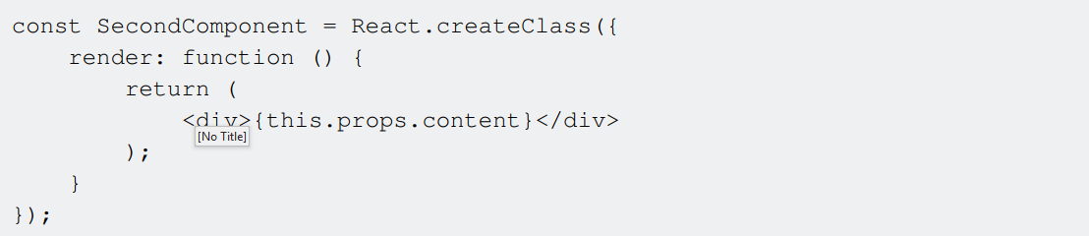
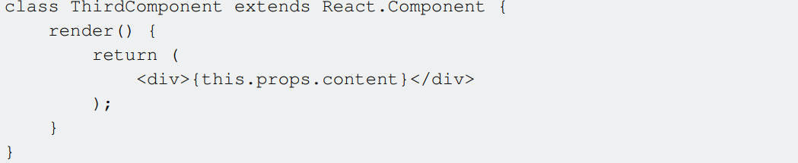
Components and Props
There are three ways of creating a React component:
Functional ("Stateless") Components
React.createClass()
ES2015 Classes
Functional components cannot have "state" within them. So if your component needs to have a state, then go for class based components.
Notes:
The above examples will all produce identical markup.

Slide 34
Communicate Between Components

Slide 35

Communication between Stateless Functional Components
Use of Redux and React Redux modules:
to handle our application state
for auto re-render of functional components
What is Redux
Redux is a predictable state container for JavaScript apps.
Redux makes it easy to manage the state of your application.
It helps you manage the data you display and how you respond to user actions.

Slide 36
Communicate Between Components
Example Application: https://jsbin.com/depavejudi/1/edit?js,output
In the example below we have three different components and one connected component.
UserInputForm: When the field value changes, it calls inputChange method on props (which is provided by the parent component) and if the data is provided as well, it displays that in the input field.
UserDashboard: This component displays a simple message and also nests UserInputForm Component. It also passes inputChange method to UserInputForm component, UserInputForm component inturn makes use of this method to communicate with the parent component.
UserDashboardConnected: This component just wraps the UserDashboard component using ReactRedux connect method.
App: This component just renders the UserDashboardConnected component

Slide 37
Communicate Between Components
There are a total of 3 cases of communication between React components:
Case 1: Parent to Child communication
Case 2: Child to Parent communication
Case 3: Not-related components (any component to any component) communication

Slide 38
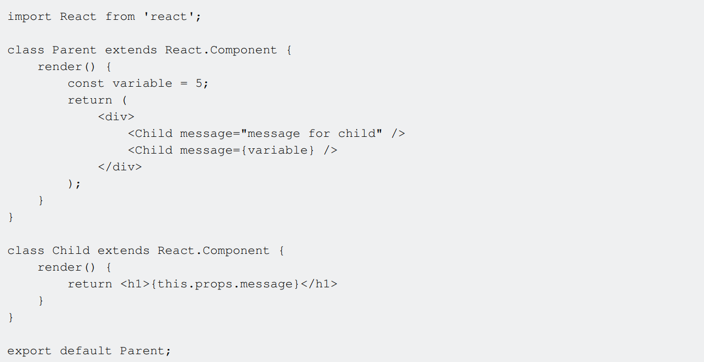
Case 1: Parent to Child communication
Props can be passed to child components.

Slide 39
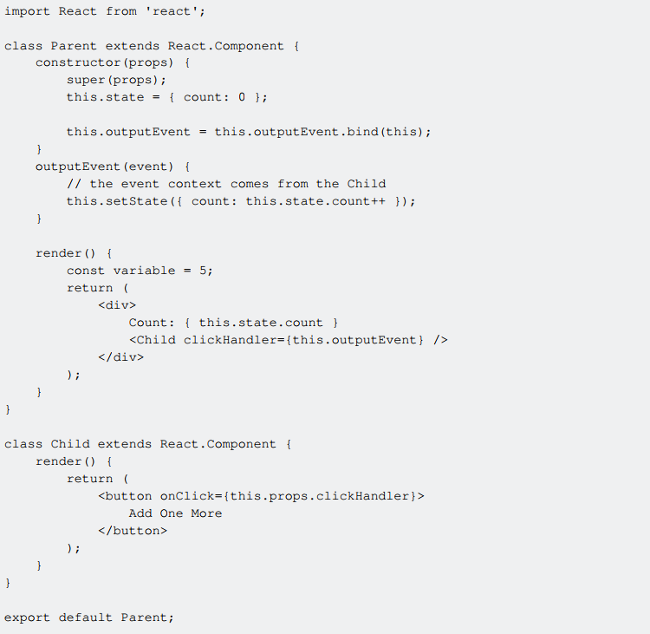
Case 2: Child to Parent communication
Sending data back to the parent.
Simply pass a function as a prop from the parent component to the child component, and the child component calls that function.

Slide 40
Case 3: Not-related components
The only way if your components does not have a parent-child relationship is to have some kind of a signal that one component subscribes to, and the other writes into.
2 basic operations of any event system: subscribe/listen to an event to be notify, and send/trigger/publish/dispatch a event to notify the ones who wants.
There are at least 3 patterns to do that.
Pattern 1: Event Emitter/Target/Dispatcher: the listeners need to reference the source to
subscribe.
Pattern 2: Publish/Subscribe: you don't need a specific reference to the source that triggers
the event, there is a global object accessible everywhere that handles all the events.
Pattern 3: Signals: similar to Event Emitter/Target/Dispatcher. Each object that could emit events needs to have a specific property with that name. This way, you know exactly what events can an object emit.

Slide 41
Components

Slide 42
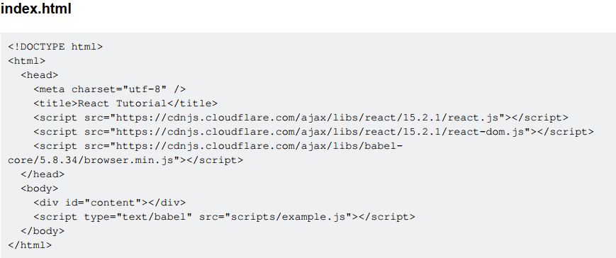
Basic Components

Slide 43
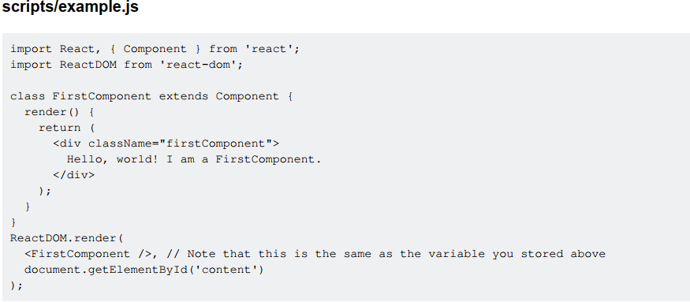
Basic Components

Slide 44
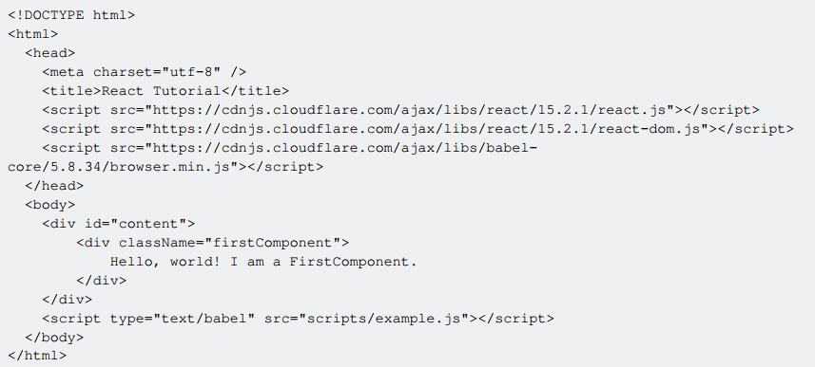
Basic Component - Final

Slide 45
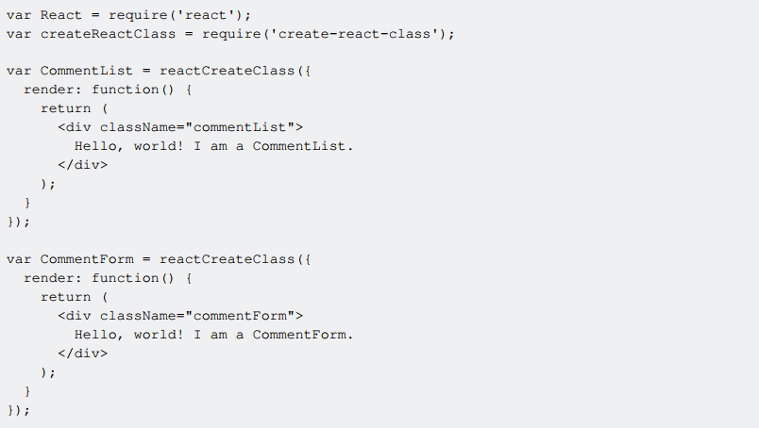
Nesting Components

Slide 46
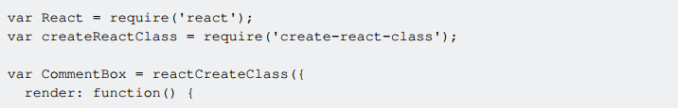
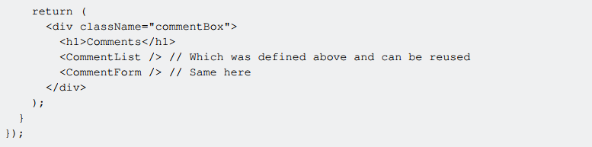
Nesting Components
You can nest and refer to those components in the definition of a different component:

Slide 47
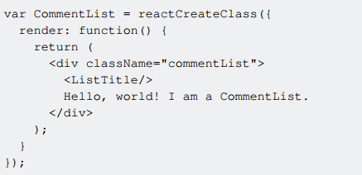
Nesting without using children
This is the style where A composes B and B composes C.
Pros
Easy and fast to separate UI elements
Easy to inject props down to children based on the parent component's state
Cons
Less visibility into the composition architecture
Less reusability
Good if
B and C are just presentational components
B should be responsible for C's lifecycle

Slide 48
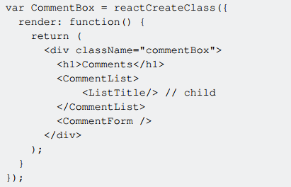
Nesting using children
This is the style where A composes B and A tells B to compose C.
Pros
Better components lifecycle management
Better visibility into the composition architecture
Better reusuability
Cons
Injecting props can become a little expensive
Less flexibility and power in child components
Good if
B should accept to compose something different than C in the future or somewhere else
A should control the lifecycle of C

Slide 49
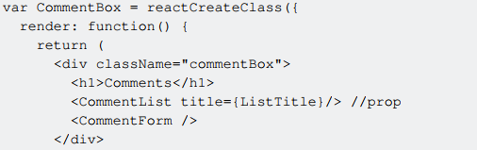

Nesting using props
This is the style where A composes B and B provides an option for A to pass something to compose for a specific purpose. More structured composition.
Pros
Composition as a feature
Easy validation
Better composaiblility
Cons
Injecting props can become a little expensive
Less flexibility and power in child components
Good if
B has specific features defined to compose something
B should only know how to render not what to render

Slide 50
Topics for Study
Stateless Components: a function or a class that has no state and returns the same markup given the same props
Stateful Components: Stateful components are always class components. Stateful components have a state that gets initialized in the constructor
High Order Components: A higher-order component (HOC) is an advanced technique in React for reusing component logic. HOCs are not part of the React API. They are a pattern that emerges from React’s compositional nature.
Working Example: http://codepen.io/vlad-bezden/pen/qrVjmW

Slide 51
Forms and User Input

Slide 52
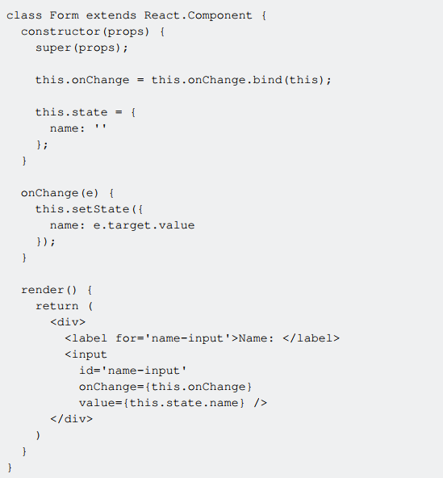
Controlled Components
Controlled form components are defined with a value property.
The example demonstrates how the value property defines the current value of the input
and the onChange event handler updates the component's state with the user's input.

Slide 53
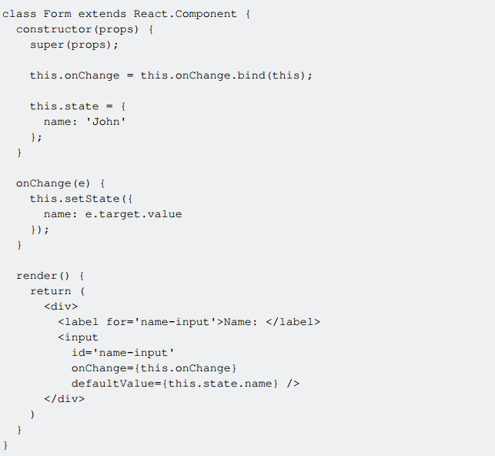
Uncontrolled Components
Uncontrolled components are inputs that do not have a value property.
In opposite to controlled
components, it is the application's responsibility to keep the component state and the input value in sync.
The component's state is updated via the onChange event handler, just as for controlled
components. However, instead of a value property, a defaultValue property is supplied.

Slide 54
JSX

Slide 55
JSX
JSX is a preprocessor step that adds XML syntax to JavaScript. You can definitely use React without JSX but JSX makes React a lot more elegant.
Just like XML, JSX tags have a tag name, attributes, and children. If an attribute value is enclosed in quotes, the value is a string. Otherwise, wrap the value in braces and the value is the enclosed JavaScript expression.
Fundamentally, JSX just provides syntactic sugar for the React.createElement(component, props, ...children) function.

Slide 56
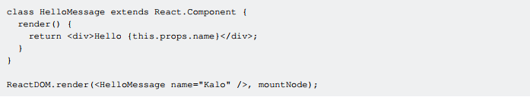
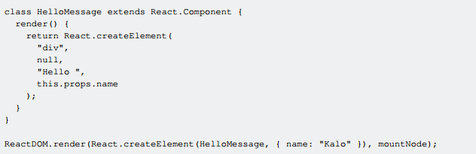
JSX
Compiles into

Slide 57
Keys in react

Slide 58
Keys in React
Keys in react are used to identify a list of DOM elements from the same hierarchy internally.
So if you are iterating over an array to show a list of li elements, each of the li elements needs a
unique identifier specified by the key property. This usually can be the id of your database item or
the index of the array.
Using the array index as a key is generally not recommended when the array is going to change over time.
From the React Docs:
As a last resort, you can pass item's index in the array as a key. This can work well if the items are never reordered, but reorders will be slow.
A good example about this: https://medium.com/@robinpokorny/index-as-a-key-is-an-anti-patterne0349aece318

Slide 59
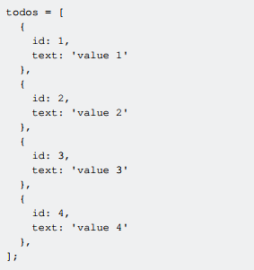
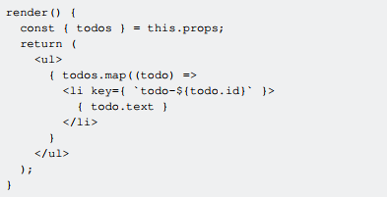
Keys in React - Using the id of an element
We are having a list of todo items that is passed to the props of our component. Each todo item has a text and id property.

Slide 60
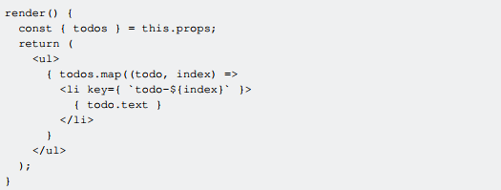
Keys in React - Using the array index
We are having a list of todo items that is passed to the props of our component. Each todo item has a text and id property.

Slide 61
Performance

Slide 62
HTML DOM vs Virtual DOM
HTML DOM is Expensive
Each web page is represented internally as a tree of objects. This representation is called Document Object Model. Moreover, it is a language-neutral interface that allows programming languages (such as JavaScript) to access the HTML elements.
In other words
The HTML DOM is a standard for how to get, change, add, or delete HTML elements.
However, those DOM operations are extremely expensive.
Virtual DOM is a Solution
So React's team came up with the idea to abstract the HTML DOM and create its own Virtual DOM in order to compute the minimum number of operations we need to apply on the HTML DOM to replicate current state of our application.
The Virtual DOM saves time from unnecessary DOM modifications.

Slide 63
How exactly?
At each point of time, React has the application state represented as a Virtual DOM.
Whenever application state changes, these are the steps that React performs in order to optimize
Performance
Generate a new Virtual DOM that represents the new state of our application
Compare the old Virtual DOM (which represents the current HTML DOM) vs the new Virtual DOM
Based on 2. find the minimum number of operations to transform the old Virtual DOM (which represents the current HTML DOM) into the new Virtual DOM
After those operations are found, they are mapped into their equivalent HTML DOM Operations
Now the minimum number of operations that have been found and transferred to their equivalent HTML DOM operations are now applied directly onto the application's HTML DOM, which saves time from modifying the HTML DOM unnecessarily.
Note: Operations applied on the Virtual DOM are cheap, because the Virtual DOM is a JavaScript
Object.

Slide 64
Props in React

Slide 65
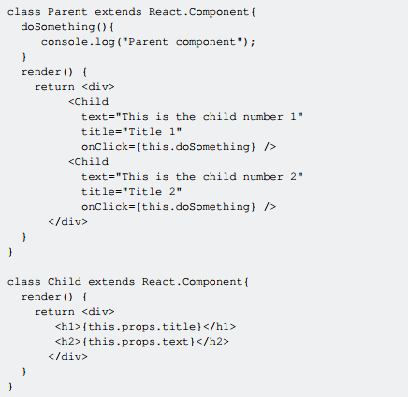
Props in React
props are used to pass data and methods from a parent component to a child component.
Interesting things about props
They are immutable.
They allow us to create reusable components.

Slide 66
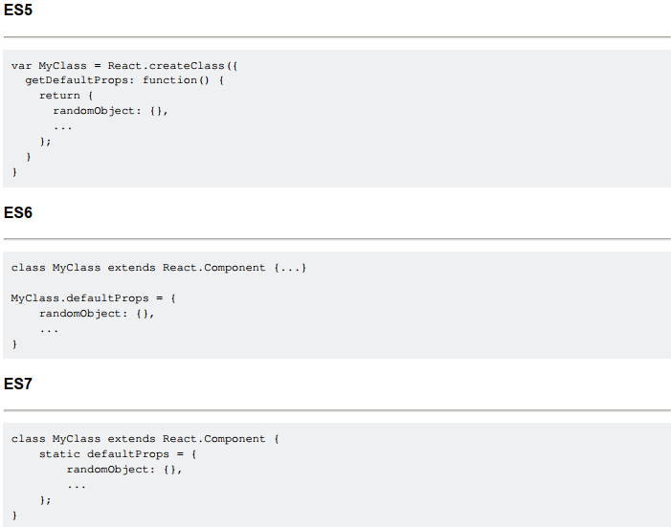
Default Props
defaultProps allows you to set default, or fallback, values for your component props.
defaultProps are useful when you call components from different views with fixed props, but in some views you need to pass different value.
The result of getDefaultProps() or defaultProps will be cached and used to ensure that this.props.randomObject will have a value if it was not specified by the parent component

Slide 67
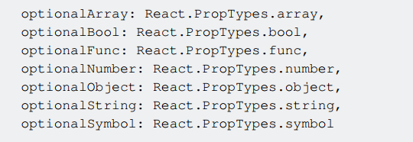
PropTypes
propTypes allows you to specify what props your component needs and the type they should be.
Your component will work without setting propTypes, but it is good practice to define these as it will make your component more readable, act as documentation to other developers who are reading your component, and during development, React will warn you if you you try to set a prop which is a different type to the definition you have set for it.
Some primitive propTypes and commonly useable propTypes are:
If you attach isRequired to any propType then that prop must be supplied while creating the instance
of that component. If you don't provide the required propTypes then component instance can not
be created

Slide 68
PropTypes
propTypes allows you to specify what props your component needs and the type they should be.
Your component will work without setting propTypes, but it is good practice to define these as it will make your component more readable, act as documentation to other developers who are reading your component, and during development, React will warn you if you you try to set a prop which is a different type to the definition you have set for it.
Some primitive propTypes and commonly useable propTypes are:
If you attach isRequired to any propType then that prop must be supplied while creating the instance
of that component. If you don't provide the required propTypes then component instance can not
be created

Slide 69
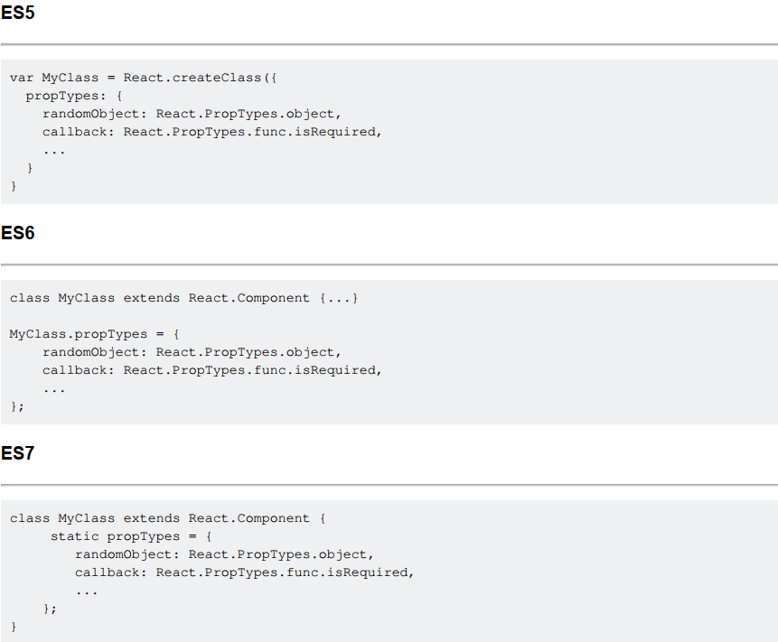
PropTypes Syntax

Slide 70
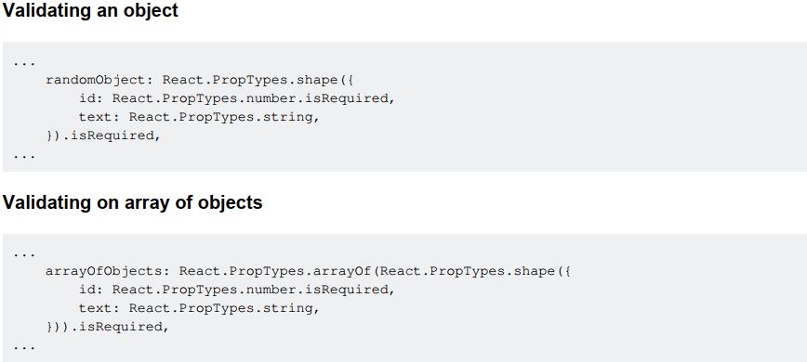
More complex props validation
In the same way, PropTypes allows you to specify more complex validation

Slide 71

Passing down props using spread operator
Instead of
Where each property needs to be passed as a single prop value you could use the spread
operator ... supported for arrays in ES6 to pass down all your values. The component will now
look like this.
Remember that the properties of the object that you pass in are copied onto the component's
props.
The order is important. Later attributes override previous ones.
Another case is that you also can use spread operator to pass only parts of props to children
components, then you can use destructuring syntax from props again. It's very useful when children components need lots of props but not want pass them one by one.

Slide 72
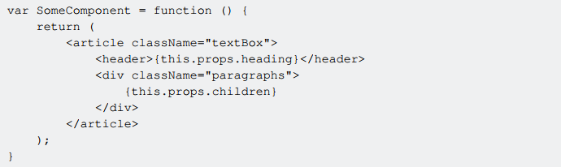
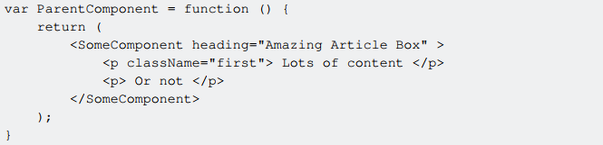
Props.children and component composition
The "child" components of a component are available on a special prop, props.children. This prop
is very useful for "Compositing" components together, and can make JSX markup more intuitive or
reflective of the intended final structure of the DOM:
Which allows us to include an arbitrary number of sub-elements when using the component later:

Slide 73
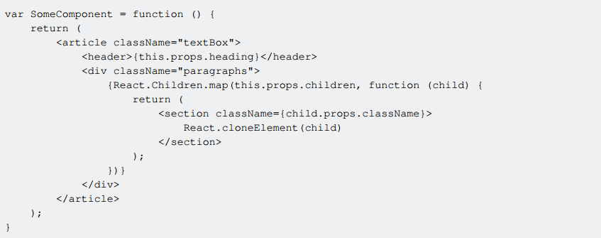
Props.children and component composition
Props.children can also be manipulated by the component. Because props.children may or may not be an array, React provides utility functions for them as React.Children. Consider in the previous example if we had wanted to wrap each paragraph in its own <section> element:
The use of React.cloneElement to remove the props from the child <p> tag - because props are immutable, these values cannot be changed directly. Instead, a clone without these props must be used.
Additionally, when adding elements in loops, be aware of how React reconciles children during a rerender, and strongly consider including a globally unique key prop on child elements added in a loop.

Slide 74
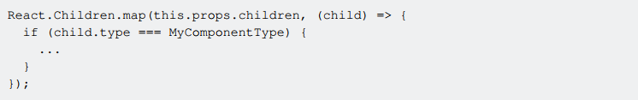
Detecting the type of Children components
Sometimes it's really useful to know the type of child component when iterating through them. In
order to iterate through the children components you can use React Children.map util function:
The child object exposes the type property which you can compare to a specific component.

Slide 75
React AJAX call

Slide 76
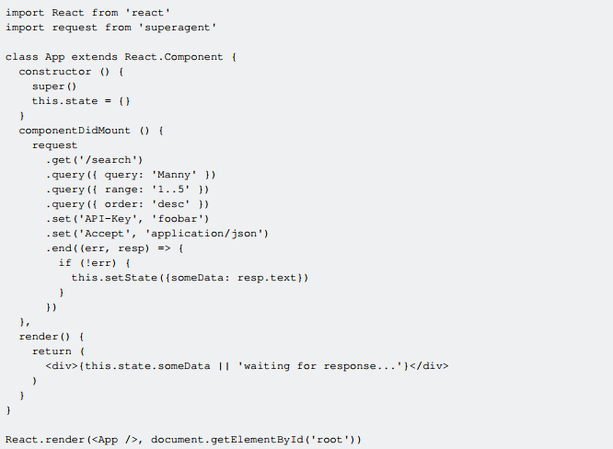
React Ajax Calls - HTTP GET request
Sometimes a component needs to render some data from a remote endpoint (e.g. a REST API).
A standard practice is to make such calls in componentDidMount method.
A request can be initiated by invoking the appropriate method on the request object, then calling .end() to send the request. Setting header fields is simple, invoke .set() with a field name and value.
The .query() method accepts objects, which when used with the GET method will form a querystring. The following will produce the path /search?query=Manny&range=1..5&order=desc.

Slide 77
React Ajax Calls - HTTP POST request
A standard practice is to make such calls in componentDidMount method.
Read More about SuperAgent: http://visionmedia.github.io/superagent/

Slide 78
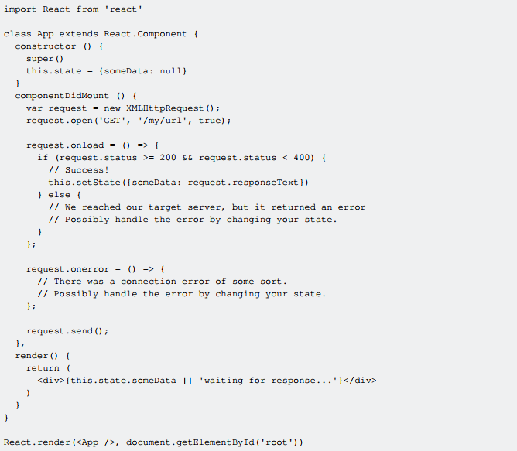
React Ajax Calls
Ajax in React without a third party library - with VanillaJS

Slide 79
React Ajax Calls
HTTP GET request and looping through data
We make an AJAX request using fetch.
We set the data we receive as component state, so we can access it inside the render method.
There, we loop through the data using map.
Don't forget to always add a unique key attribute (or prop) to the looped element, which is important for React's rendering performance.
Notes:
https://jsbin.com/varigiw/edit?js,output

Slide 80
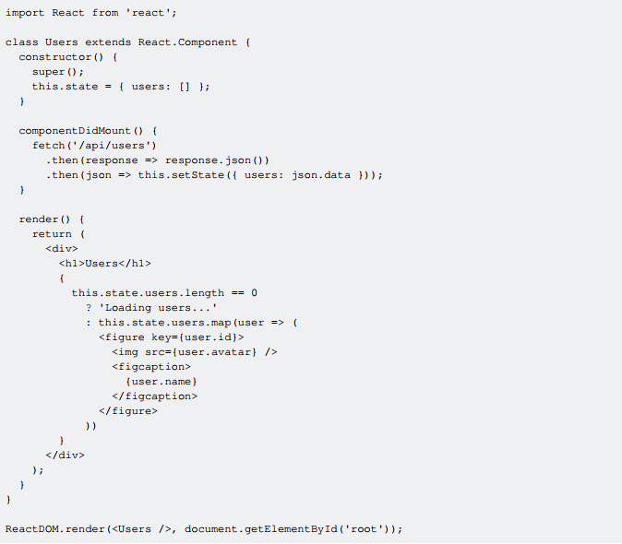
React Ajax Calls
HTTP GET request and looping through data
We make an AJAX request using fetch.
We set the data we receive as component state, so we can access it inside the render method.
There, we loop through the data using map.
Don't forget to always add a unique key attribute (or prop) to the looped element, which is important for React's rendering performance.
Notes:
https://jsbin.com/varigiw/edit?js,output

Slide 81
React Forms

Slide 82
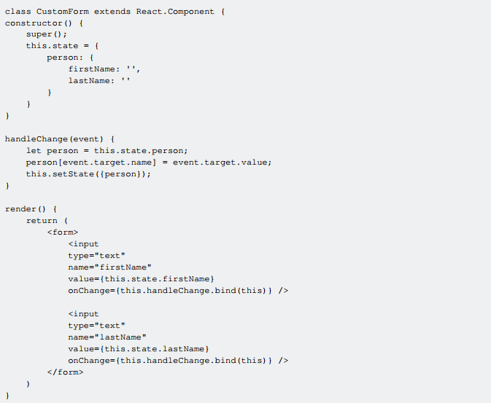
React Forms
A controlled component is bound to a value and its changes get handled in code using event based callbacks.
In the example we initialize state with an empty person object. We then bind the values of the 2 inputs to the individual keys of the person object.
Then as the user types, we capture each value in the handleChange function. Since the values of the components are bound to state we can rerender as the user types by calling setState().

Slide 83
React Routing

Slide 84
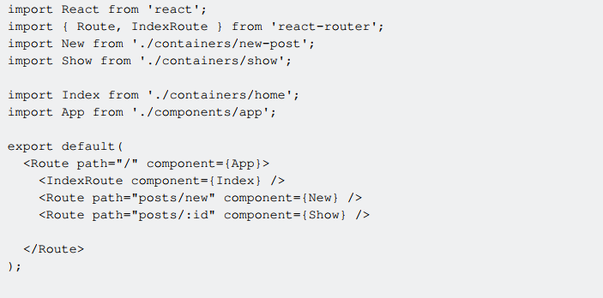
React Routing
Place a file like the following in your top level directory. It defines which components to render for which paths

Slide 85
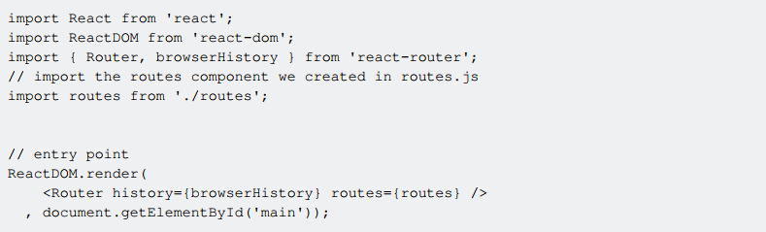
React Routing
In top level index.js that is the entry point to the app, you need only render this Router component:
Now it is simply a matter of using Link instead of <a> tags throughout your application.

Slide 86
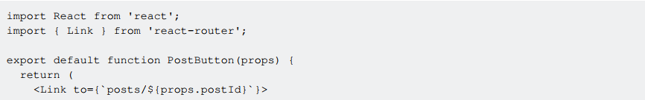
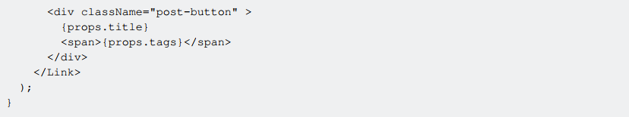
React Routing
Using Link will communicate with React Router to change the React Router route to the specified link,
which will in turn render the correct component as defined in routes.js

Slide 87
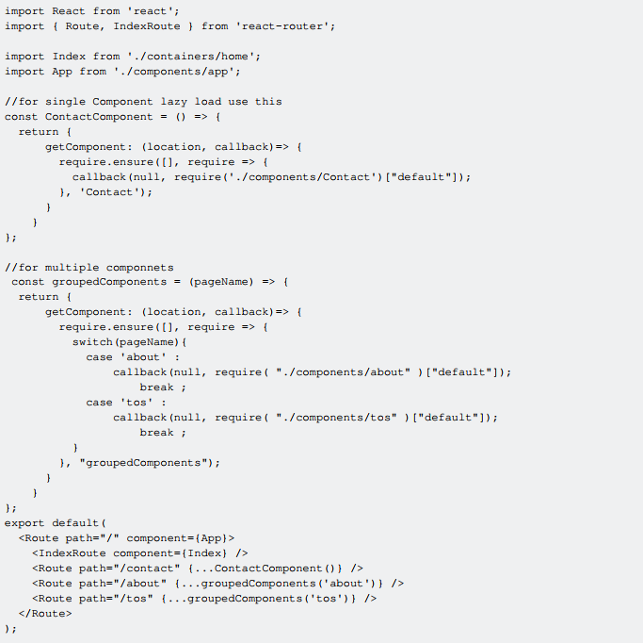
React Routing Async

Slide 88
Using ReactJS with Typescript

Slide 89
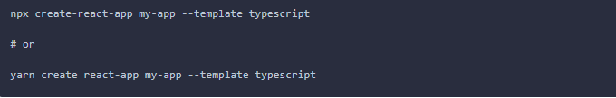

ReactJS component written in Typescript
Create typescript app with CRA
Add TypeScript to a React App project
And Instead of 'jsx' file's extension, typescript projects use 'tsx’ file extension
Resources: TypeScript Handbook
TypeScript Example on React

Slide 90


ReactJS component written in Typescript

Slide 91

ReactJS component written in Typescript

Slide 92


Thank you for your attention
Follow us

